Slide 1
COMP 3400
Week 9 - Monday

Slide 2
Last time
What did we talk about last time?
Network security
Symmetric cryptography
Public key cryptography
Cryptographic hash functions

Slide 3
Questions?

Slide 4
Assignment 5

Slide 5
TLS

Slide 6
Transport-Layer Security
Transport-Layer Security (TLS) adds end-to-end security to TCP
Secure versions of protocols often add an "s" to their names: HTTPS, SFTP, and IMAPS
These protocols use TLS
With TLS, the TCP data is encrypted
However, the TCP headers are not encrypted
If they were, the OS wouldn't know which port to deliver them to
Because network traffic needs to know where to go, it's usually possible to do traffic analysis, even when the data is encrypted

Slide 7
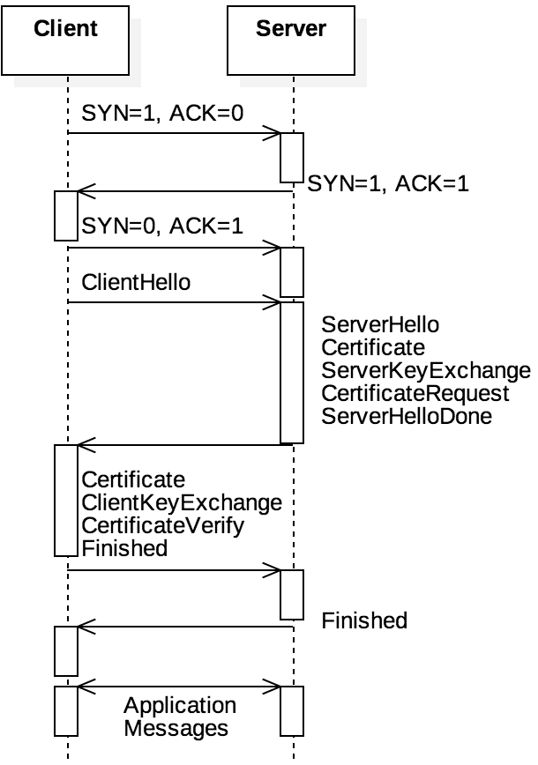
TLS handshake
With TLS, the connection first performs a TCP three-way handshake
Then, the client and the server perform a TLS handshake that uses public key cryptography to agree on a session key
The session key is used to communicate securely using symmetric key encryption (probably AES) during the TCP session

Slide 8
Confidentiality and integrity
Because the data in the TCP segments is encrypted with AES, the information's confidentiality is maintained
To protect integrity, a message authentication code (MAC) of the TCP headers is attached as an optional TCP field
The MAC is a cryptographic hash digest, probably using SHA-2
These are the broad strokes, but there are many details
Details change with each version of TLS
We're up to TLS 1.3 now

Slide 9
Security is hard
TLS is the successor to SSL
SSL had three versions but was eventually replaced by TLS because of security flaws
Security flaws exist in TLS 1.0, 1.1, and 1.2, leading to the adoption of TLS 1.3
In some cases, the flaws are because encryption algorithms that were discovered to be insecure are allowed
In other cases, the protocols themselves had vulnerabilities that could be exploited
Key takeaway:
Security is not one-and-done
Application security should be designed so that it's easy to change over to newer standards

Slide 10
Internet Layer

Slide 11
Internet layer
TCP and UDP provide a framework for end-to-end communication between processes
But they ignore the fact that different hosts are communicating
The Internet layer provides a system for getting messages from host to host
The data plane gives the structure of the network, using Internet Protocol (IP) addresses
The control plane controls how messages are routed through the network

Slide 12
Special subnets
Three ranges of IP addresses are reserved in IPv4 for private subnets:
192.168.0.0/16 (2¹⁶ = 65,536 possible devices)
172.16.0.0/12 (2²⁰ = 1,048,576 possible devices)
10.0.0.0/8 (2²⁴ = 16,777,216 possible devices)
The first range is probably familiar to you because it's used for most home networks
IPv6 has its own range, fd00::/8, that allows for up to 2⁶⁴ devices

Slide 13
NAT
So that different subnets can communicate, a router connects the private subnet to the Internet
The router has a private IP address, used to communicate with the subnet, and a public IP address, used to communicate with the rest of the world
Routers do network address translation (NAT), a kind of IP masquerading
The outside world only sees the router's IP
When the router gets a message, it sends it to the appropriate device in the private subnet
The router observes traffic and changes port numbers on incoming and outgoing packets so that multiple devices behind the router can communicate with a single server

Slide 14
Visualization of subnets
Alice's Home
Bob's Home
192.168.1.3
192.168.1.5
192.168.1.7
192.168.1.3
192.168.1.1
192.168.1.0
Internet
75.3.28.14
75.3.28.27
ISP

Slide 15
IPv4 packet format
version distinguishes between IPv4 and IPv6
protocol is TCP or UDP
checksum is just for the header and does no checking for the payload
TTL gives the number of times the packet can be forwarded (keeps packets from hopping around forever)
Like UDP, IP makes no guarantees about reliability
The purple options fields are variable length
0-3 | 4-7 | 8-11 | 12-15 | 16-19 | 20-23 | 24-27 | 28-31
version | length | type of service |  | total length
identification |  |  |  | flags | fragment offset
TTL |  | protocol |  | checksum
source address
destination address
options
payload (transport-layer segment)

Slide 16
IP packet example
Here's an example of the values (in hex) that might be stored in an IPv4 packet
Note that IPv6 packets are similar but simpler, because they don't have optional fields
Header | 4500 0060 0000 0000 08 06 6862 867e 8ddd 5dd8 d822 | IPv4, length = 20 bytes (5 words) total length = 96 bytes ID, flags, offset (not used here) TTL protocol (TCP) checksum source address 134.126.141.221 destination address 93.184.216.34
Payload | …

Slide 17
Network routing protocols
The Internet is a network of networks
Each independent network controlled by a single entity is called an autonomous system (AS)
Each AS connects to other ASes at gateway routers
BGP is a protocol that describes how these routers communicate to each other the paths through them to other networks
Within an AS, OSPF, RIP, and other protocols determine the fastest route through the network
OSPF uses Dijkstra's shortest path algorithm based on time delays, broadcasting information to other routers
Alternatively, when a router using RIP discovers a new shortest path, it forwards the information only to its neighbors

Slide 18
Link Layer

Slide 19
Link layer
The Internet layer focuses on routing packets through networks
The link layer focuses on forwarding packets from point to point
This forwarding all happens within a single kind of technology
Things can go wrong at this fundamental level of networking:
Processing delay because checksums and other information have to be computed
Queuing delay because other packets are waiting to be sent
Transmission delay because converting to the physical layer takes work
Propagation delay because the physical layer can't send data instantly
All these delays can add up

Slide 20
Ethernet
Ethernet is one of the best known examples of link level protocols
Ethernet is a collection of standards for communicating over copper or fiber optics
Like higher level protocols, Ethernet also wraps its data with a header (and a footer too)
Typically, link layer packets are called frames
For historical reasons, Ethernet frames are described in octets (always 8 bits) rather than bytes (which used to be variable in size)

Slide 21
Ethernet frames
An Ethernet frame uses:
8 octets for a preamble that's always the same, to mark the start of a message
6 octets for destination address
6 octets for source address
2 octets for type of Ethernet
A payload of variable size
4 octets for a cyclic redundancy check (CRC), an error checking value computed from the whole frame that is stronger than a checksum
Source and destination addresses are media access control (MAC) addresses that are usually the same for a device's entire life
Address Resolution Protocol (ARP) is used to ask devices on the network for their MAC based on their IP
Size | 8 octets | 6 octets | 6 octets | 2 octets | varies | 4 octets
Purpose | Preamble | Destination | Source | Type | Payload | CRC
Example | aaaaaaaaaaaaaaab | f0def12cc22b | f45c89bd332d | 0800 | ... | 64713722

Slide 22
Stacks on stacks on stacks
Here's an example of all the layers together:
Ethernet header | aaaa aaaa aaaa aaab f0de f12c c22b f45c 89bd 332d 0800
IPv4 header | 4500 0060 0000 0000 0806 6862 867e 8ddd 5dd8 d822 |  |  | Ethernet Payload
TCP header | 1388 0050 0000 0017 0000 002a 5010 1000 cf33 0000 |  | IPv4 Payload
HTTP header | 4745 5420 2f20 4854 5450 2f31 2e31 0d0a 486f 7374 3a20 6578 616d 706c 652e 636f 6d0d 0a43 6f6e 6e65 6374 696f 6e3a 2063 6c6f 7365 0d0a 0d0a | TCP Payload
Ethernet FCS | 6471 3722

Slide 23
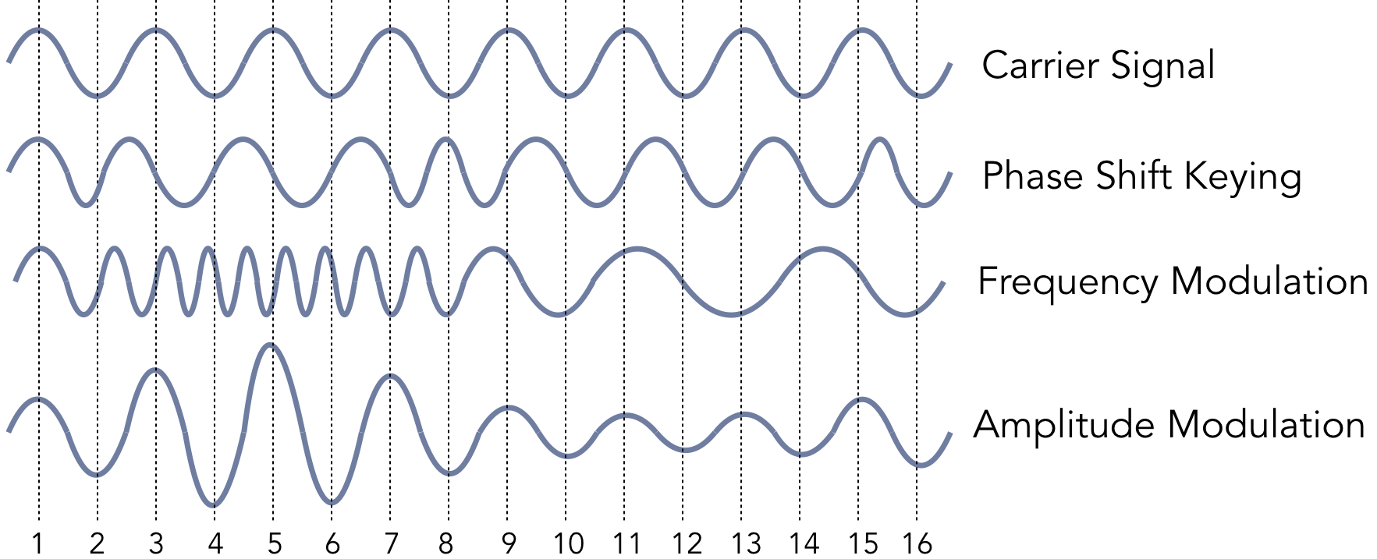
A glimpse at the physical layer
Below the link layer, the physical layer is actually communicating bits
Bits are communicated as waves of light or radio signals, through air, fiber optics, or copper
There are different ways of carrying a signal in a wave
Deeper than that requires us to talk about more physics and electrical engineering than we want to right now

Slide 24
Wireless
Wireless communication differs from wired at the link and physical layers and sometimes above
There are a few important wireless network technologies:
Wi-Fi is a set of standards designed to replace normal wired networking connections
Bluetooth is designed for short-range mobile ad hoc networks (MANETS)
Uses a star topology where many peripherals connect to a central devices
Zigbee uses a wireless mesh network for communicating between many low powered devices
Popular for Internet of Things (IoT) applications

Slide 25
Threading

Slide 26
Threads and processes
Many processes can run concurrently
Each one executes independently
Each process has its own memory layout
Many threads can also run concurrently
Each one executes independently
Each thread has its own stack to keep track of its function calls
But all threads within a process share code, data, heap, and kernel segments
Just as we used fork() to spawn new processes, there are libraries to spawn new threads within a process and coordinate them

Slide 27
Advantages of threads
Using threads allows for more modular software since threads can call the same functions within a program
Threads can be more efficient since there's no context switch needed for different threads to interact
Some models of programming like GUIs depend on threads so that one unit of code needs can react to an action taken elsewhere
Since threads share memory, there's no need for IPC libraries

Slide 28
Disadvantages of threads
Threads are less isolated from each other than separate processes
Consequences:
A thread crashing from a segmentation fault will kill the entire process, including the other threads
Bugs called race conditions occur, where the behavior of the program is different depending on which thread executed first

Slide 29
Race conditions
Race conditions are a central problem with threads
Thread scheduling is non-deterministic
It's often impossible to predict when the statements from one thread are going to be executed with respect to those in another thread
If the statements modify the same memory, the results can be inconsistent
One of the most frustrating issues with race conditions is that they can occur rarely
This means that you can run your program 1,000 times with no problems, only to crash badly on time 1,001

Slide 30
Race condition scenarios
The following are common causes of race conditions:
Two or more threads trying to modify a global variable at the same time
One thread calls free() on data that another thread is using
Thread A is using variables declared on the stack of Thread B, which become invalid when Thread B terminates
Two or more threads calls a non-thread-safe function at the same time

Slide 31
Upcoming

Slide 32
Next time…
Thread safety
POSIX threads

Slide 33
Reminders
Work on Assignment 5
Due Friday by midnight
Read sections 6.4 and 6.5
Study for Exam 2
Next Monday!

